Slide 1
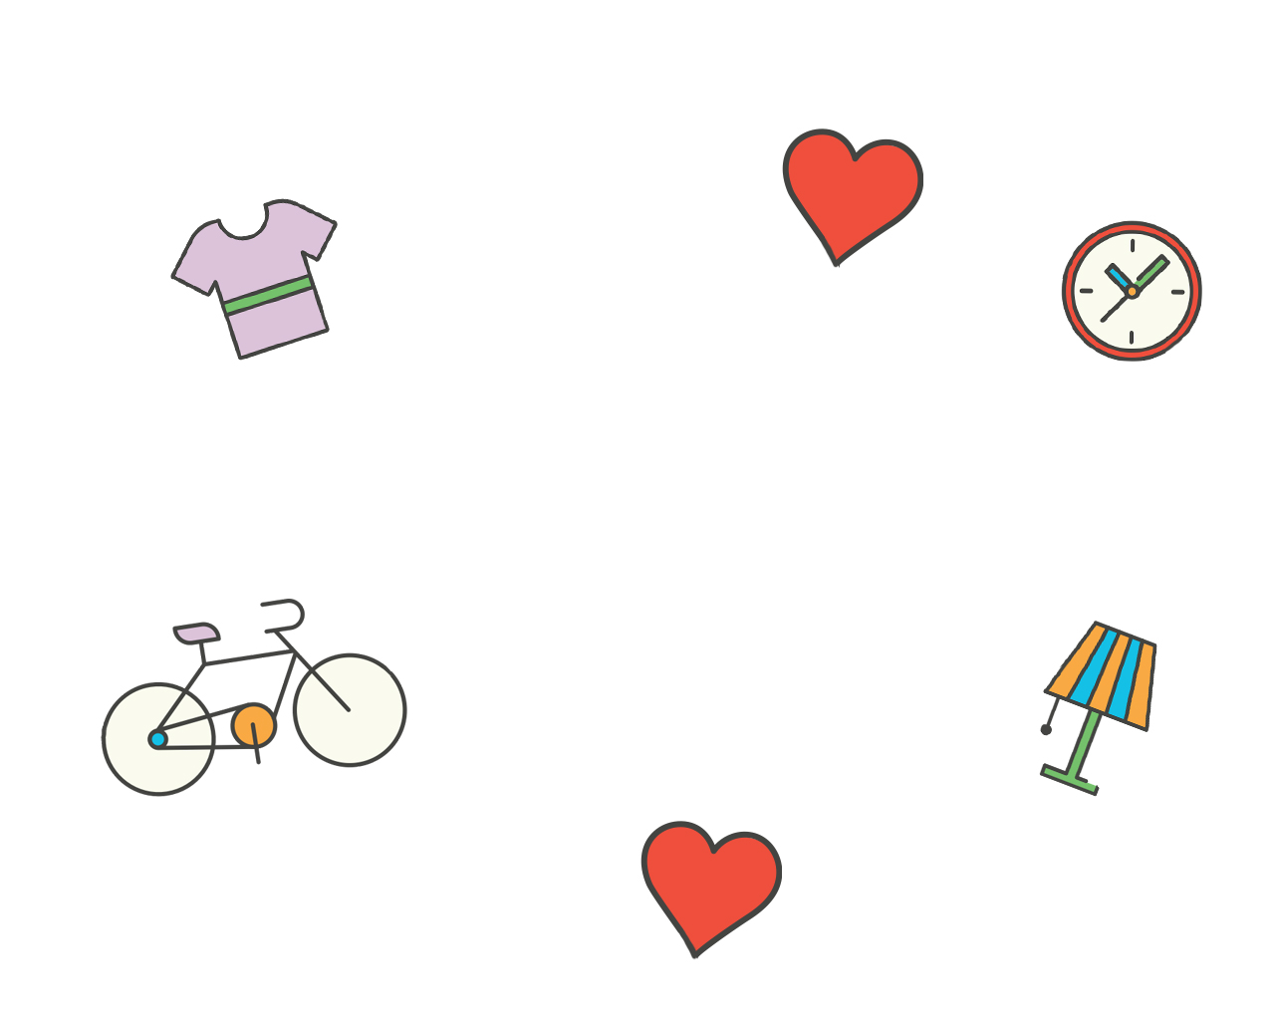
Team HaCaCam
Project 3
WDI-30
Web Development Immersive
Notes:
This template can be used as a starter file for a photo album.

Slide 2
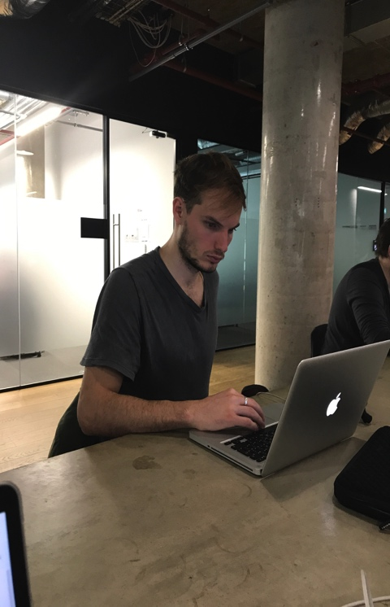
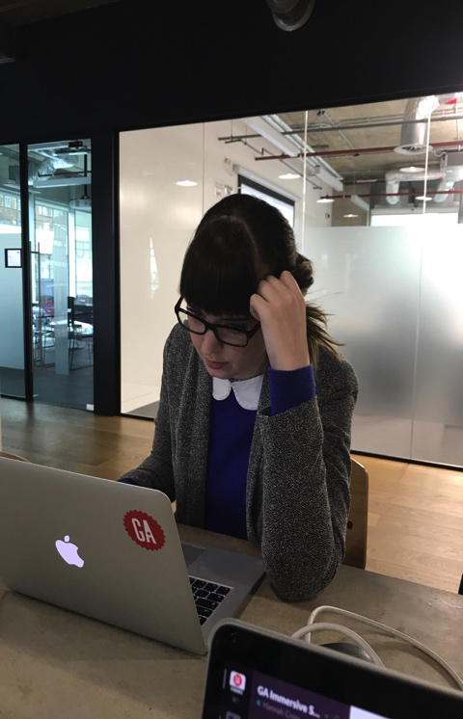
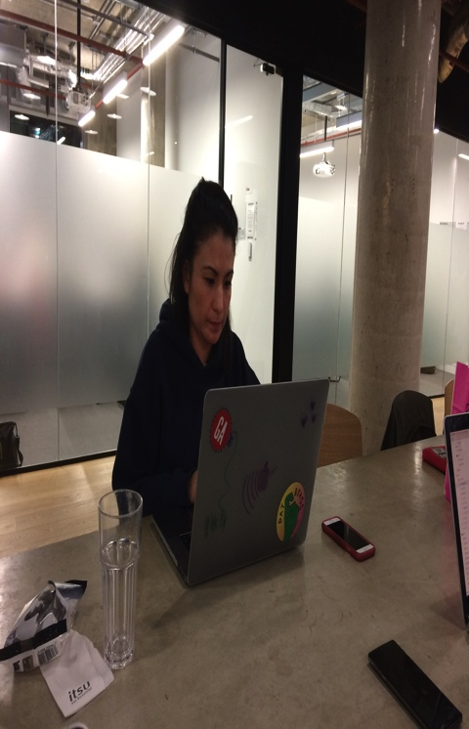
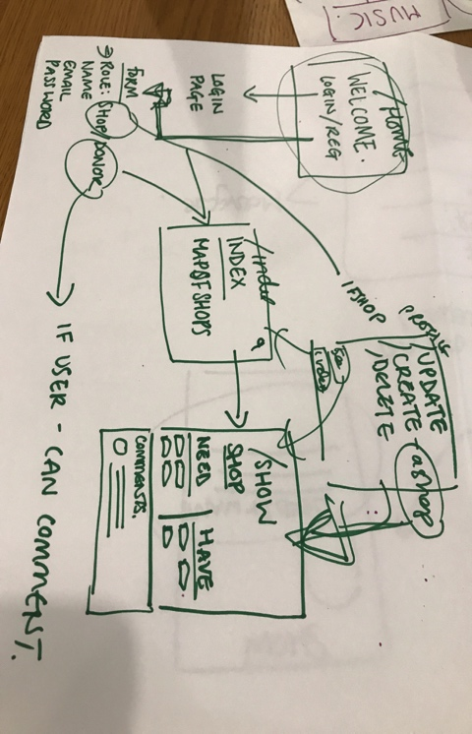
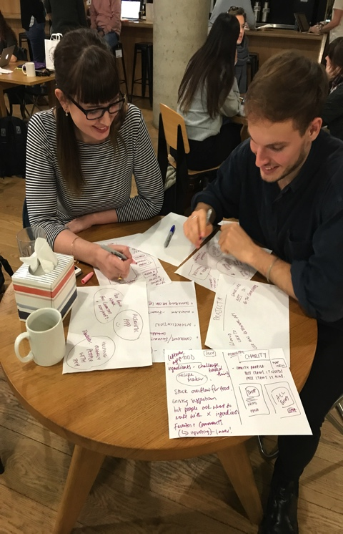
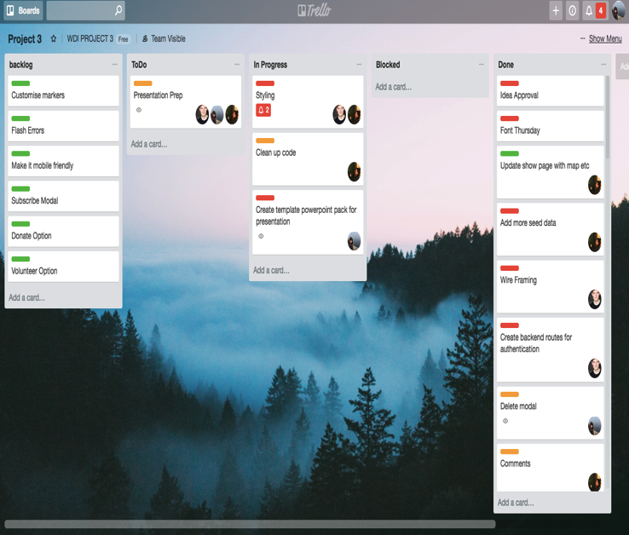
Team HaCaCam at work..

Slide 3
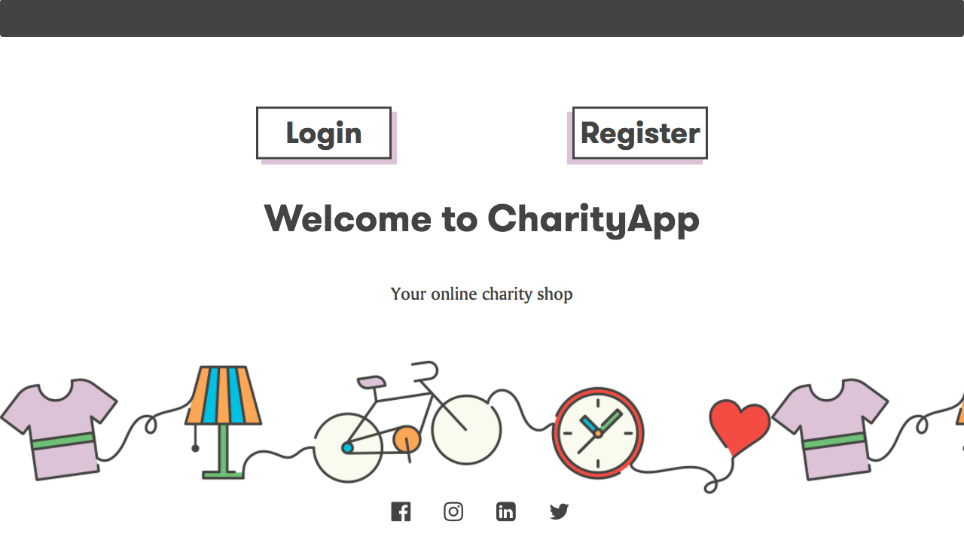
Why did we create our app?

Slide 4






Give customers an opportunity to find shops that tailor to their clothing needs
Give charity shops a platform to connect with customers
Ensure charity shops receive more of the goods the customers want to buy, and less of the rest
Why did we create our app?
Provide a scalable platform for communication between charity shops and their customers
Provide charity shops with the opportunity to advertise for free

Slide 5

Things we struggled with
Things we struggled with..

Slide 6
Things we struggled with
The easy(ish) bits…

Slide 7
Things we struggled with
Learning points
Its all about communication

Slide 8
Things we struggled with
Any questions?

